Slide 1
Chest Pneumonia Detection
Data Analysis and Machine Learning Using Python Internship
One Man Army
Harshit Gupta

Slide 2
Outline
Dataset Description
Preparing the Data to feed into the Model
Data Visualisation

Slide 3
Dataset Description
5856 X-Ray Images
Train
Test
Validation
Pneumonia
Normal
Normal
Pneumonia
Normal
Pneumonia
234
390
1341
3875
8
8
J. Melendez, G. B. Van, P. Maduskar et al., “A novel multiple-instance learning-based approach to computer-aided detection of tuberculosis on chest x-ray,” IEEE Transactions on Medical Imaging, vol. 34, no. 1, pp. 179–192, 2015.

Slide 4
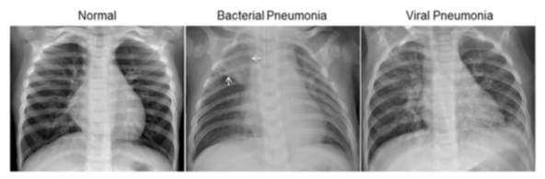

Slide 5
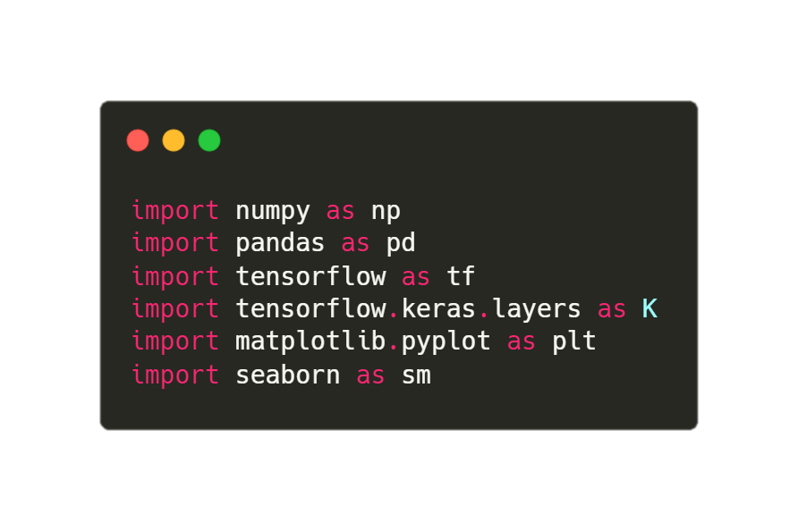
Libraries

Slide 6
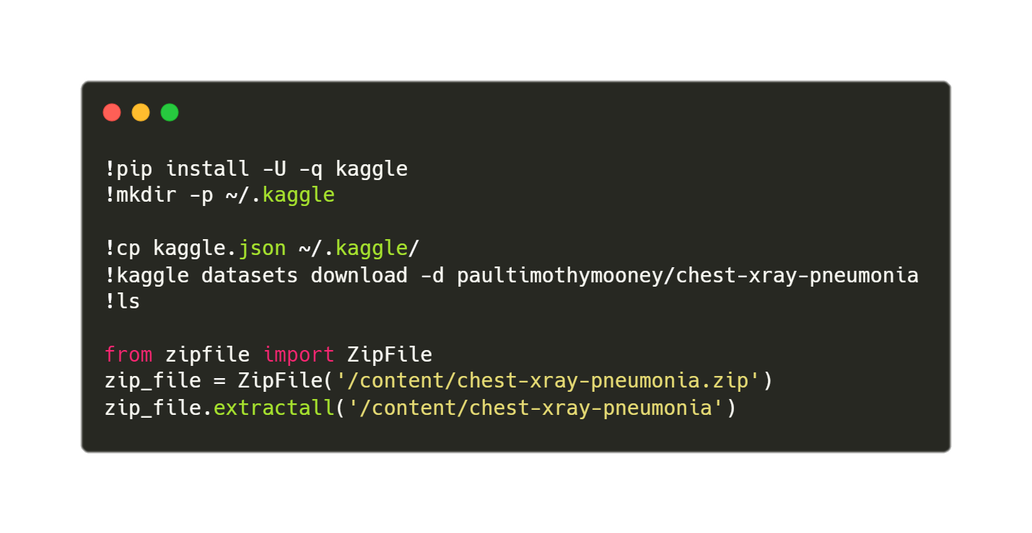
Fetching The Dataset

Slide 7
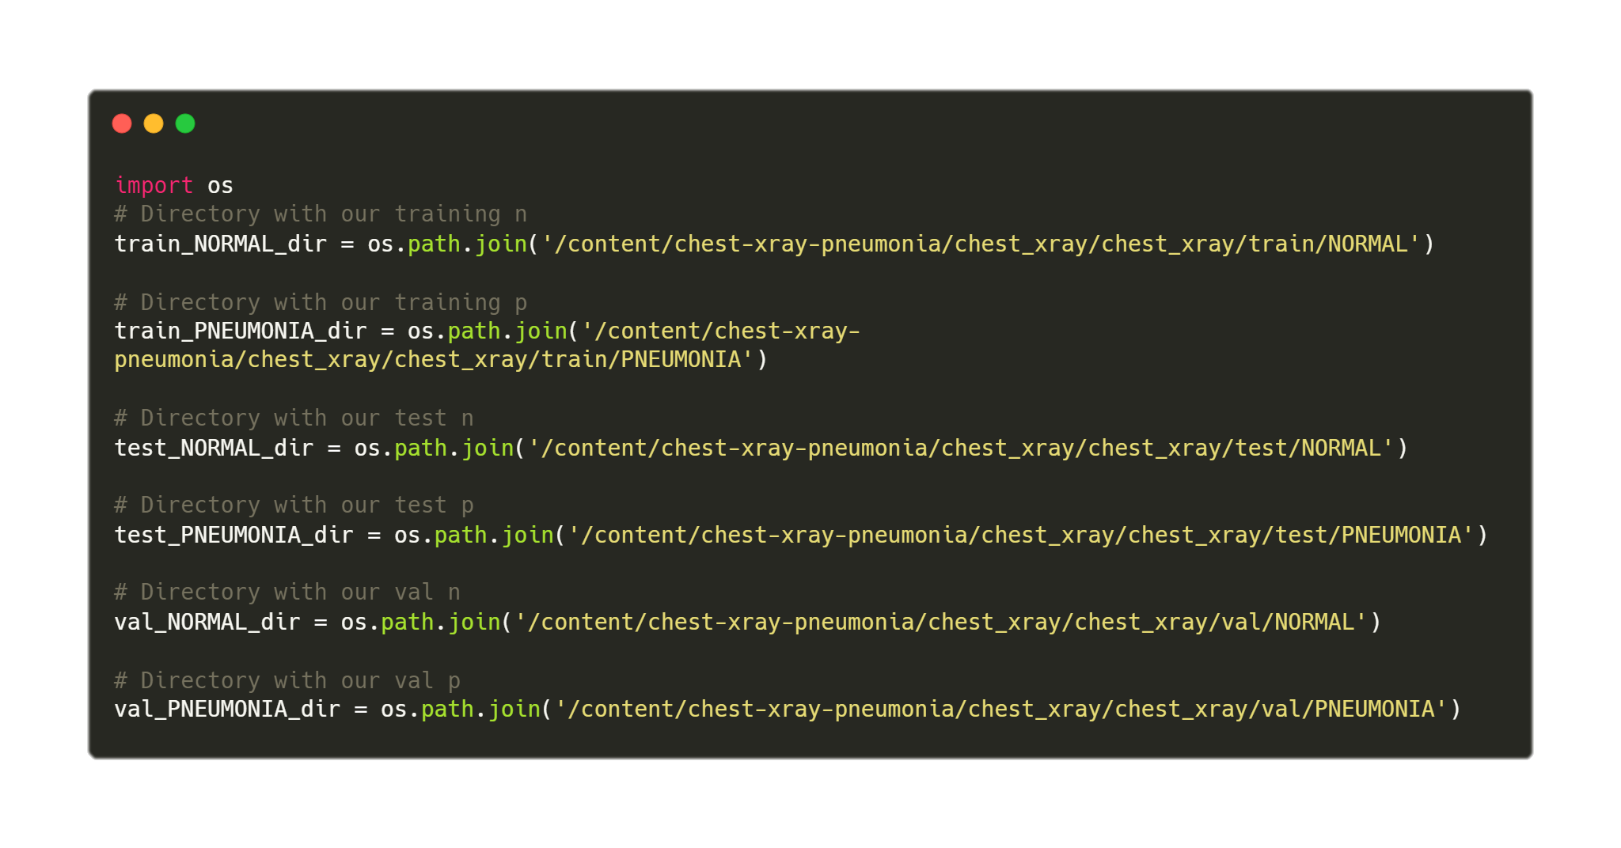
Setting up the variables

Slide 8
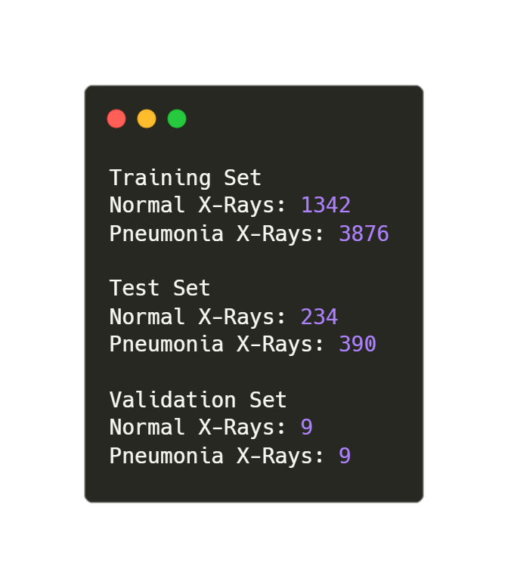
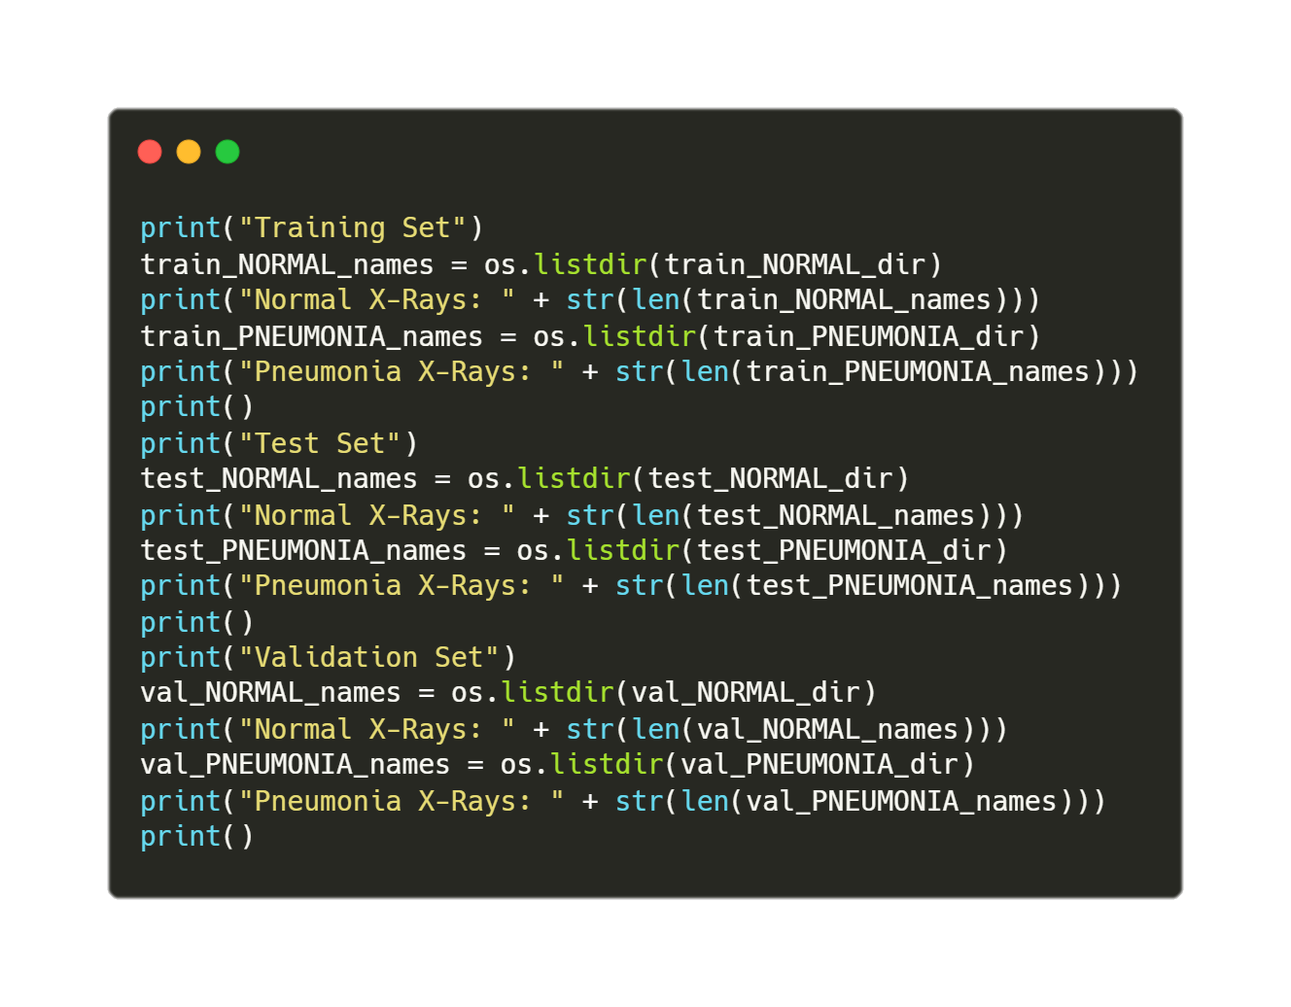
Number of clean images
Source Code
Output

Slide 9
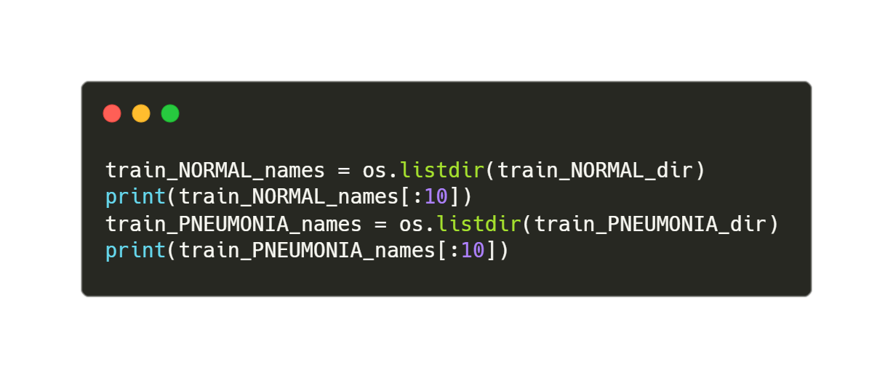
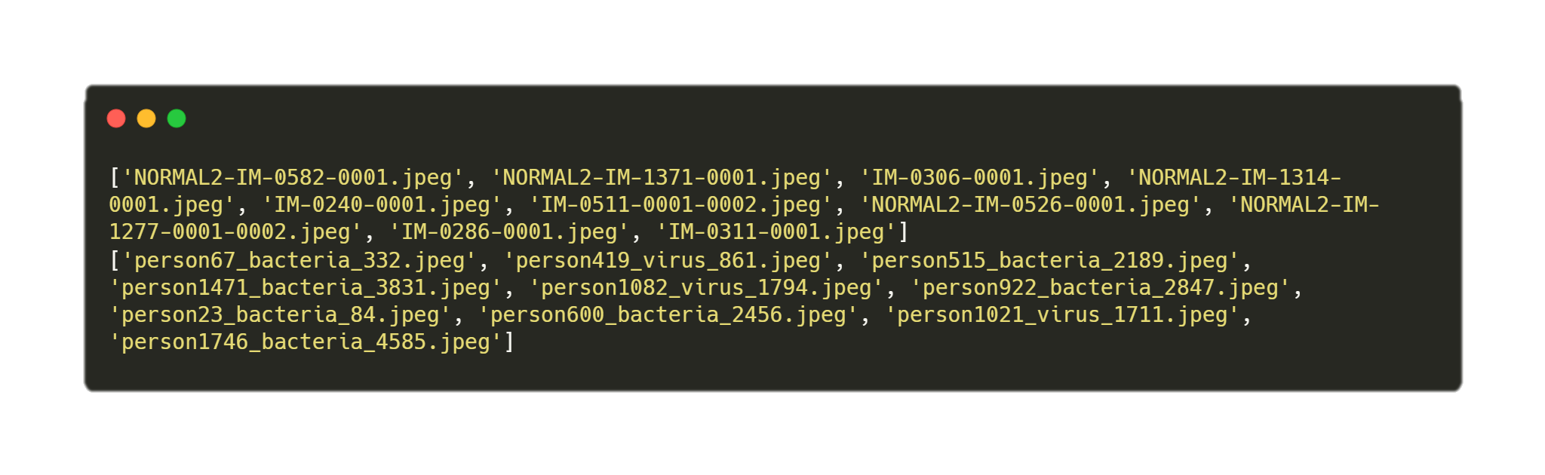
Image Name Samples
Source Code
Output

Slide 10
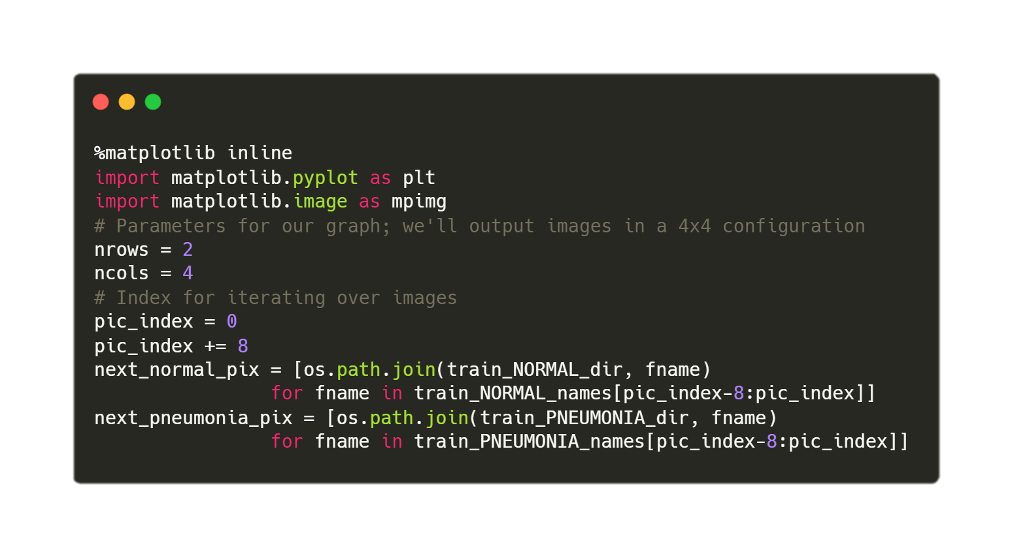
Image Samples – Setting up the plot

Slide 11
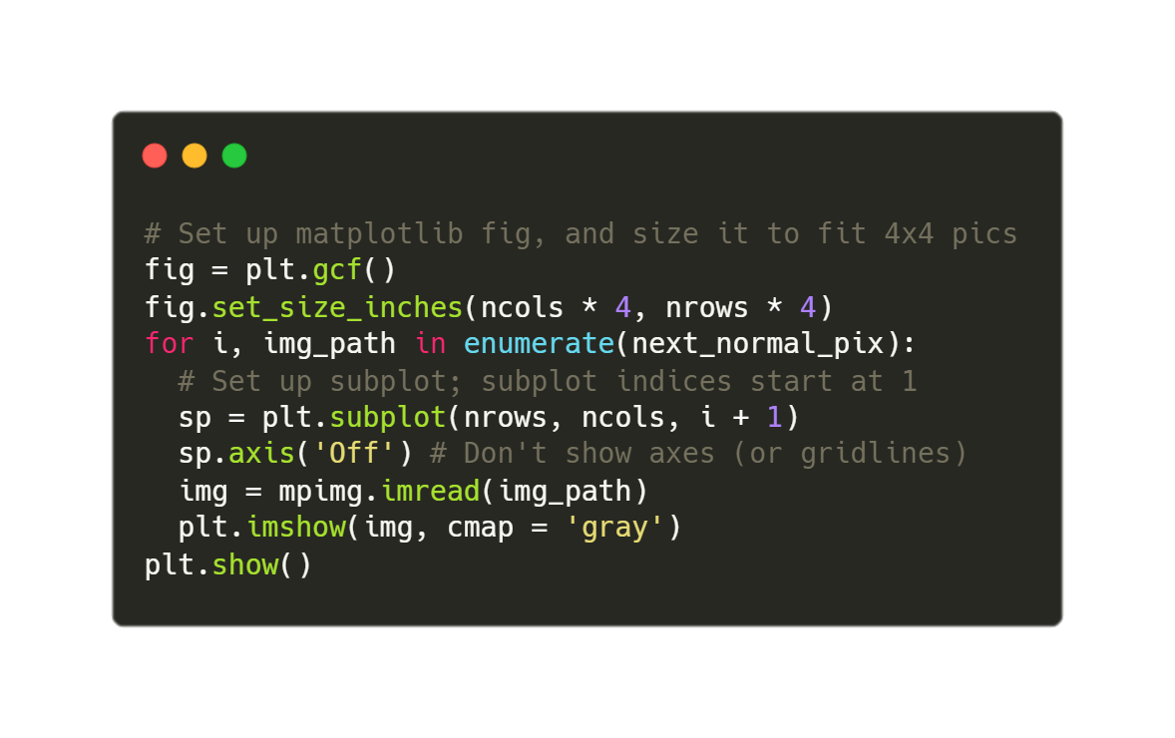
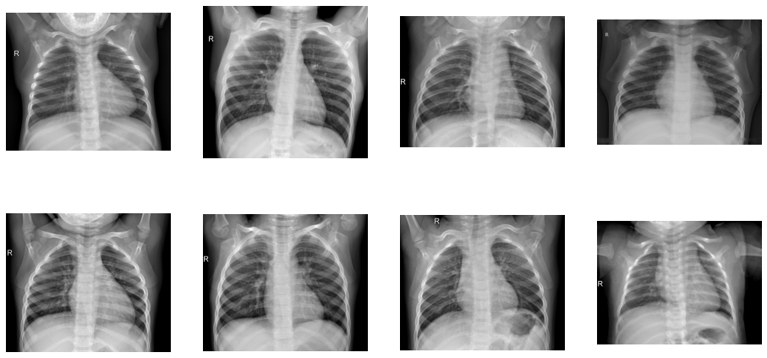
Normal X-Ray Samples
Source Code
Output

Slide 12
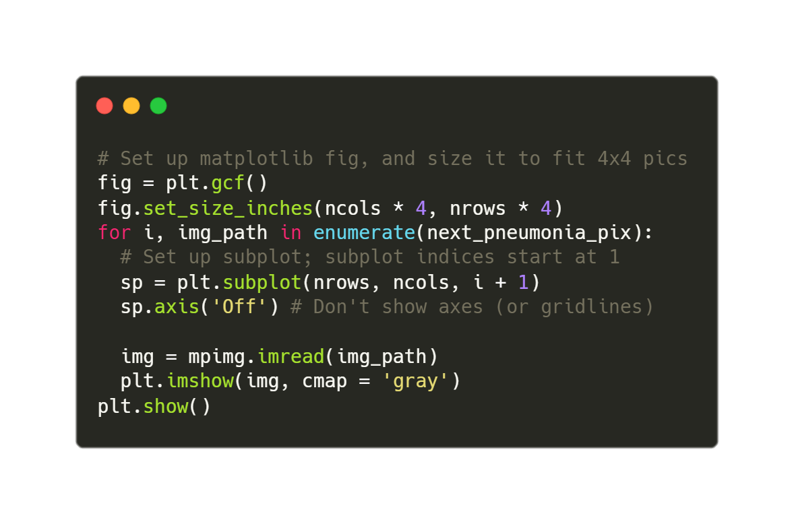
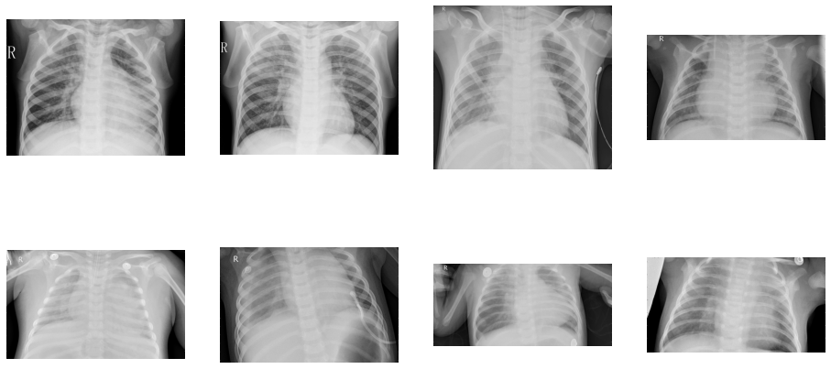
Pneumonia X-Ray Samples
Source Code
Output

Slide 13
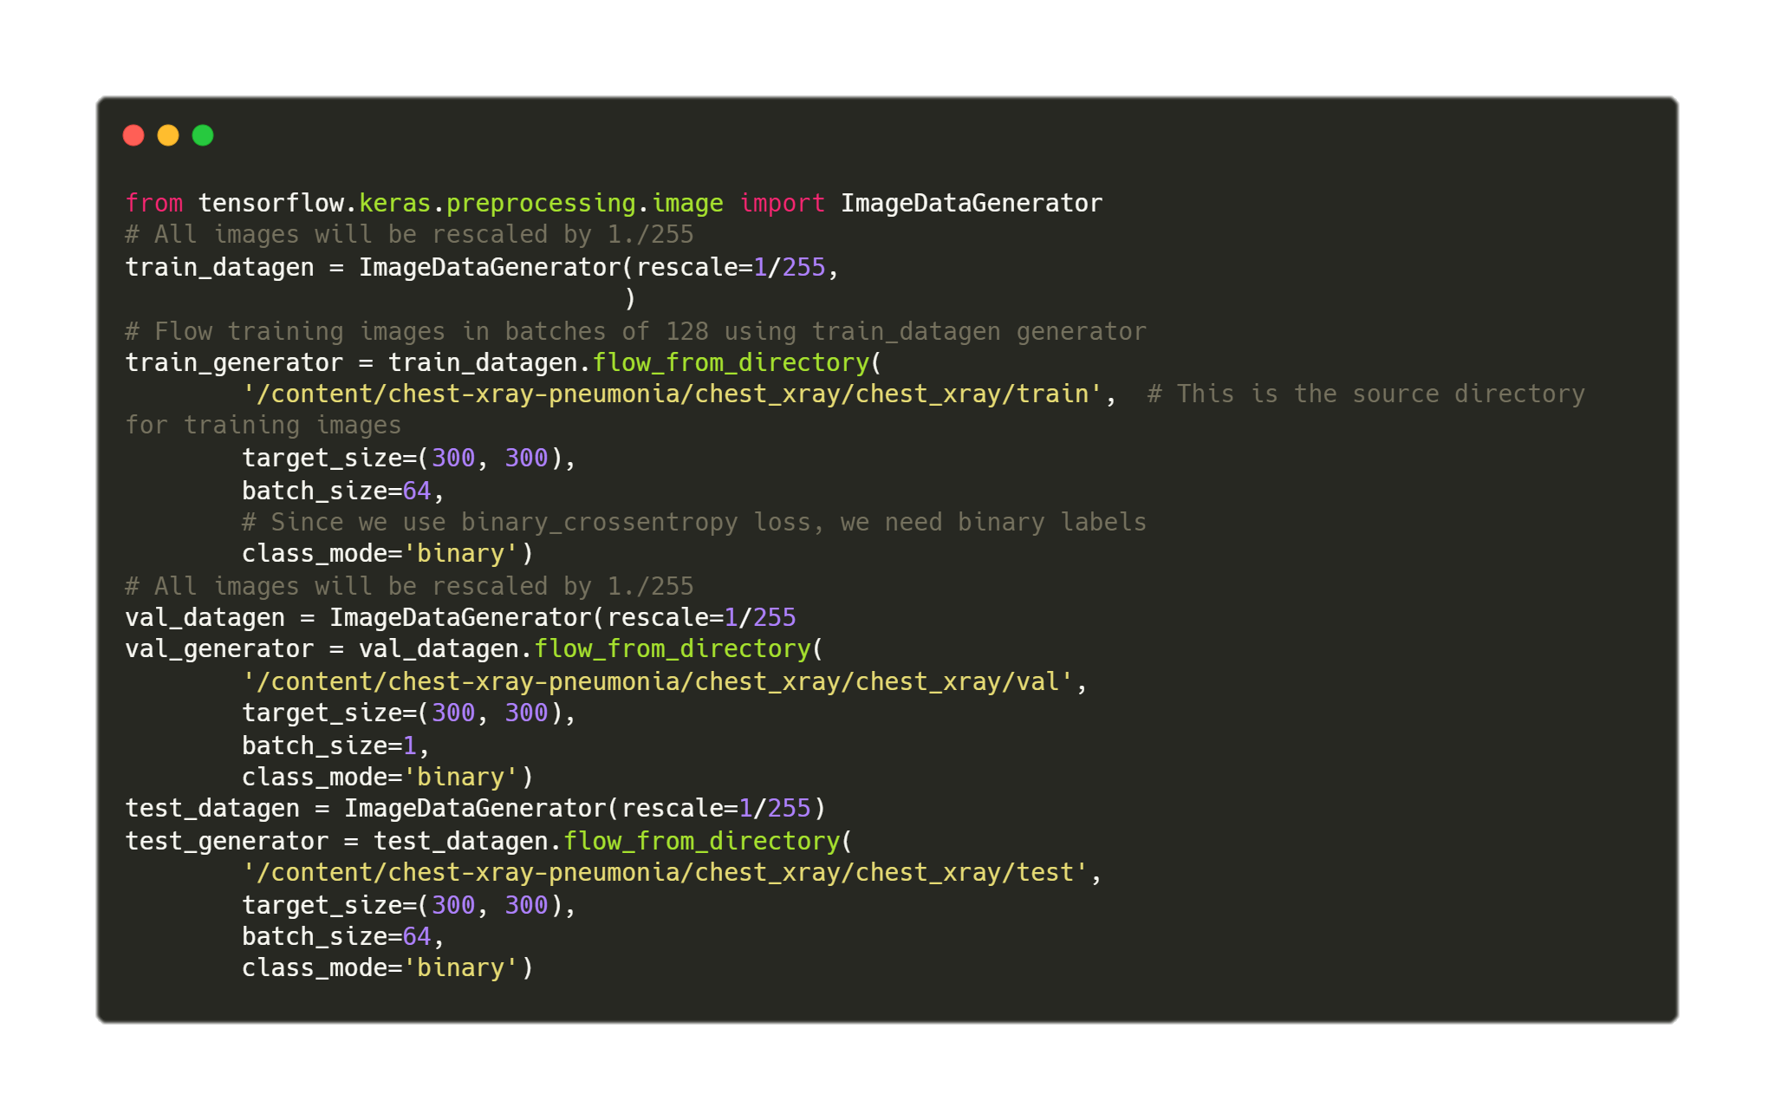
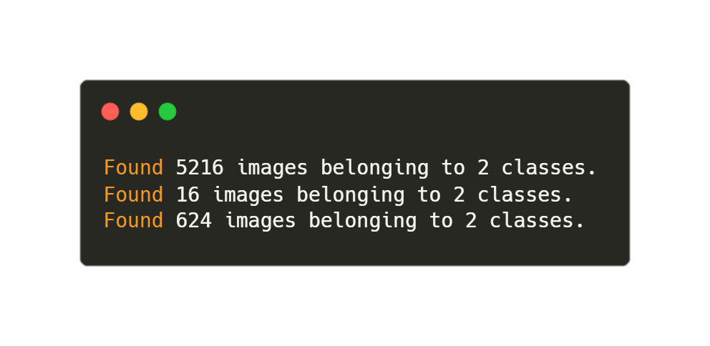
Preparing Generator To Feed Model
Source Code
Output

Slide 14
Thank You
Harshit Gupta

